Slide 1
Introduction to Supervised Learning
Definition:Supervised learning is a type of machine learning where the model learns from labeled training data. In supervised learning, the dataset is composed of input-output pairs, where the input data is typically represented as features or attributes, and the output, known as the label or target, is the desired prediction or classification.
Goal: The goal of supervised learning is to train a model on a labeled dataset, where each input is associated with a corresponding target output. The main objectives include:
Learning a Mapping Function: The model learns a mapping from input features to the target output based on the provided labeled data.
Generalization: The trained model should generalize well to unseen data, meaning it should make accurate predictions on new inputs that were not part of the training set.
Prediction: Once trained, the model can be used to predict the output for new inputs that it hasn't seen before, based on the learned patterns from the training data.
Evaluation: The performance of the model is evaluated using metrics appropriate for the specific task (e.g., accuracy, precision, recall for classification; mean squared error for regression) to assess how well it performs on unseen data.
Supervised learning is widely used in various applications such as image and speech recognition, natural language processing, recommendation systems, and more. It forms the basis for many machine learning algorithms, including decision trees, support vector machines, neural networks, and deep learning models.

Slide 2
Key Concepts in Supervised Learning
Labeled Data: The training dataset consists of examples where each example includes both input features and corresponding output labels. For example, in a dataset of handwritten digits:
Input (features): Images of digits (e.g., pixel values).
Output (labels): Corresponding digit (e.g., "0", "1", ..., "9").
Training and Testing: Process of learning the model from training data and evaluating it on testing data.
Overfitting and Underfitting: Challenges in model training.

Slide 3
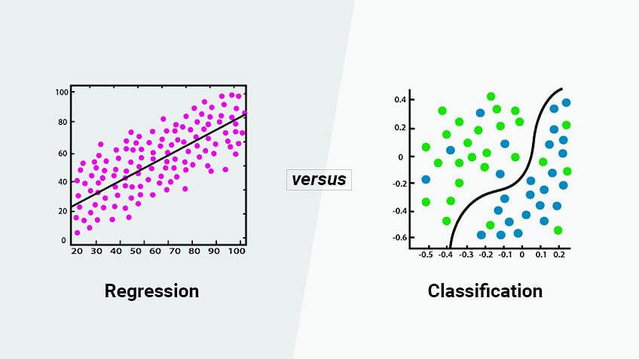
Types of Supervised Learning Algorithms
Regression: The task of predicting a continuous numerical value. Example: Predicting housing prices based on features like size, location, etc.
Classification: The task of predicting a categorical label or class from a set of possible classes. Example: Email spam detection (classifying emails as spam or not).

Slide 4
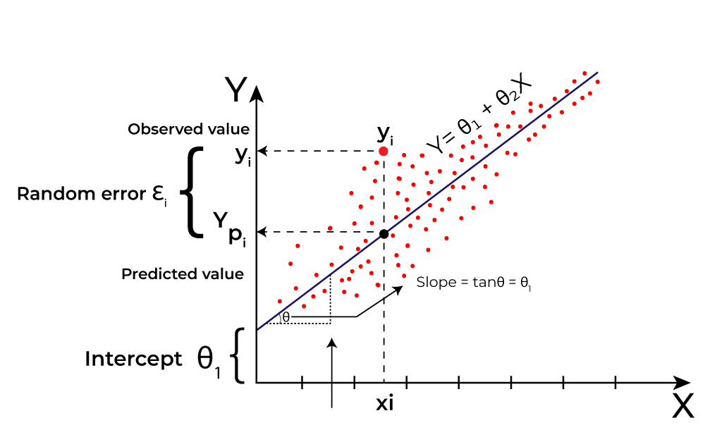
Linear Regression
Definition: Linear regression is a fundamental technique in supervised learning used for predicting continuous values. It models the relationship between a dependent variable (target) and one or more independent variables (features) by fitting a linear equation to observed data.
Application: Example - Predicting house prices based on features like size, location, etc.

Slide 5
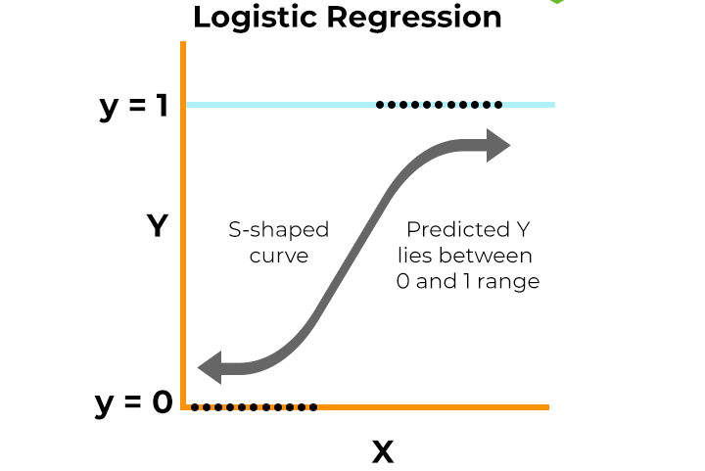
Logistic Regression
Definition: Logistic regression is another fundamental technique in machine learning used for binary classification tasks. Despite its name, it's actually a linear model for binary classification that predicts the probability of a binary outcome based on input features.
Application: Example - Predicting whether an email is spam or not based on its content.

Slide 6
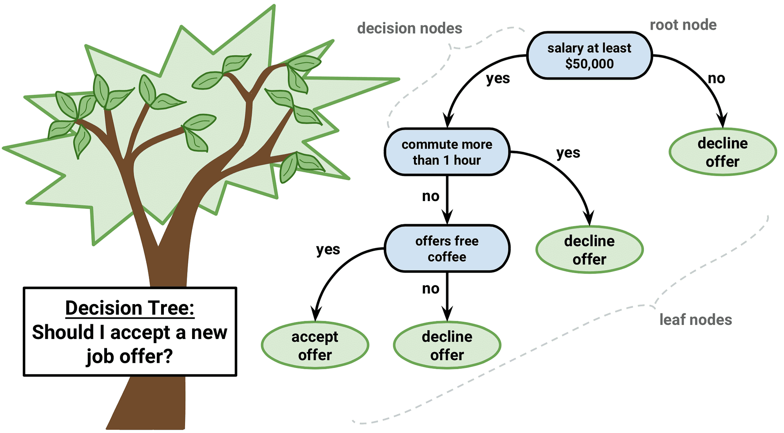
Decision Trees
Definition: A decision tree is a versatile and intuitive supervised learning algorithm used for both classification and regression tasks. It works by recursively partitioning the data into subsets based on the most significant attribute at each node.
Application: Example - Classifying whether a person will buy a product based on their age, income, etc.

Slide 7
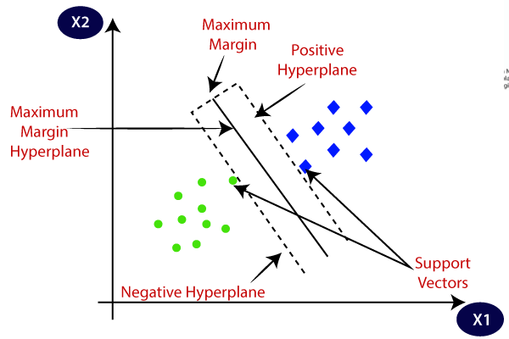
Support Vector Machines (SVM)
Definition: SVMs are supervised learning models used for classification and regression by finding the hyperplane that best divides the data into classes
Basics of Support Vector Machines (SVMs)
Objective:
SVMs aim to find the optimal hyperplane that best separates classes in a feature space.
For classification, SVMs maximize the margin between the hyperplane and the nearest data points (support vectors).
Hyperplane:
In a two-dimensional space, the hyperplane is a line that separates the data into two classes.
In higher-dimensional spaces, the hyperplane becomes a hyperplane that separates data points into different classes.
Margin:
The margin is the distance between the hyperplane and the closest
data points from both classes.
SVMs maximize this margin to improve generalization to new data.
Support Vectors:
Support vectors are the data points closest to the hyperplane and
determine its orientation.
These points are crucial because they influence the position and
orientation of the optimal hyperplane.

Slide 8

Neural Networks
Definition: Neural networks are a class of machine learning models inspired by the structure and function of the human brain. They have gained immense popularity due to their ability to learn complex patterns and relationships in data.
Application: Example - Handwriting recognition.

Slide 9

Example: Predicting House Prices
Dataset: Description of features like size, number of bedrooms, location, etc.
Algorithm: Linear regression used to predict house prices.
Outcome: The model predicts prices with a certain accuracy.

